Slide 1
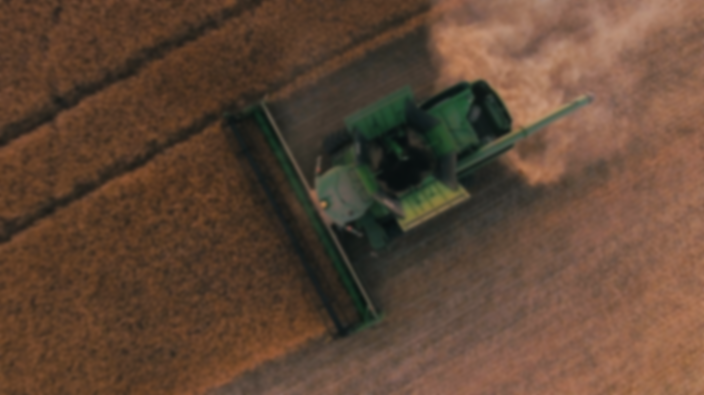
Krishi
Taking the agriculture industry forward
01

Slide 2

Team Details
Team Name
Team Kira
Shobhit Tewari (18103086) Gaurang Gupta (18103033) Gagan Sroay (18103032) Adamya Mishra (18103008)
College Name
NIT Jalandhar
02

Slide 3

Problem Statement
Agriculture industry is the backbone of our economy. Without the agriculture industry, the entire system would collapse. There are farmers who are not able to afford tractors, labor, harvester and inventory. Farmers can buy the equipment once they are stable but to reach that point, they need to continue working.
The above mentioned becomes a sort of vicious circle. The farmers need equipment for better growth and then can invest on equipment. This is the gap that needs to be addressed and someone needs to put a stop in this circle. Here is where our attention was needed.
03

Slide 4
Our Solution
01
Connecting tractors with local farmer.
02
Connecting harvester and labor
03
Rating the best of services
04
Service at your finger tips
05
Yet to explore with farmer
Harvester are expensive and labor are tricky. People wanting to offer their services can benefit the farmers.
Rate your service providers based on their nature and skills to help yourself and other farmers with the best of services
Don’t have enough money to invest on the equipment yet? Borrow it and pay for the current land only
While we tried our best to give you the best of the best, we may have some shortcomings. Let’s help each other to make India a better place
Our system connects the farmers with the local tractor owners to provide for their land on monetary basis.
04

Slide 5

Tech Stacks
Front-End Back-End Services
HTML5 CSS
React.JS React Native
NodeJs Express MongoDB Android/iOS
Position Stack Twilio SMS
Google Maps Push Notifications
05

